Slide 1
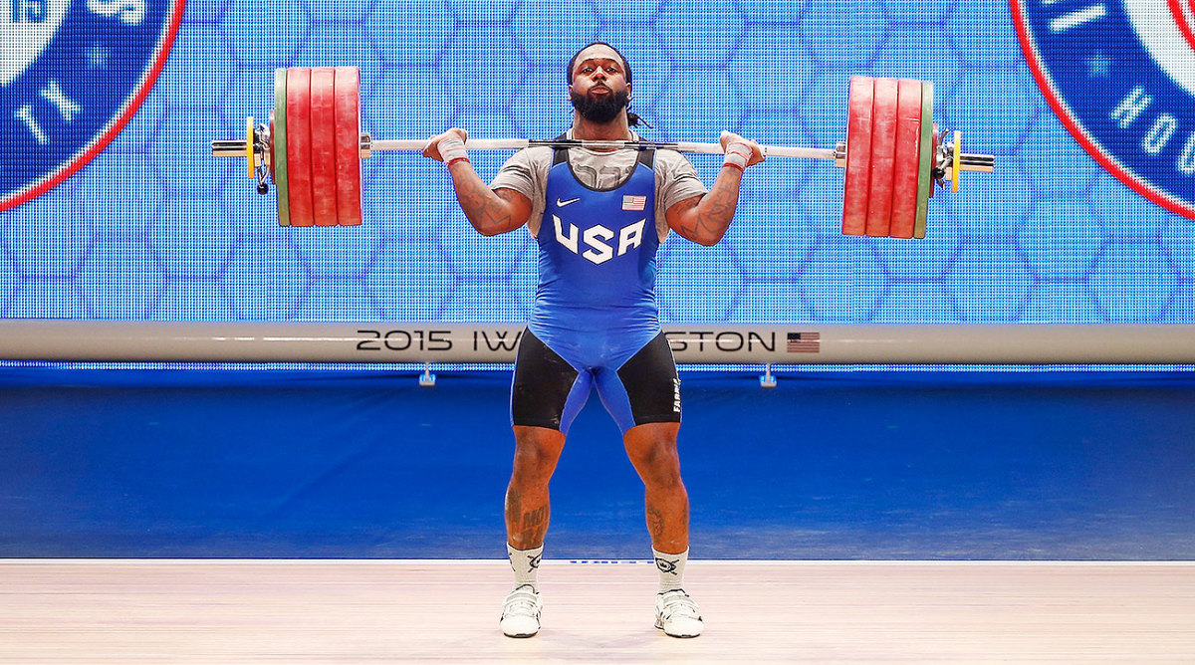
Biomechanical analysis for weightlifting performance enhancement
Project ID : 24-25J-275

Slide 2
Introduction
Weightlifting demands precise and efficient movement patterns to optimize performance and reduce injury risks. Traditional biomechanical analysis methods rely on costly equipment like motion capture systems, limiting accessibility for athletes and coaches. This gap in accessibility hinders detailed feedback on lifting techniques, potentially compromising performance and safety.
Emerging technologies in computer vision and machine learning offer a promising alternative. These advancements enable detailed biomechanical analysis from video footage, making analysis more accessible and affordable. However, current solutions often lack specificity for weightlifting techniques such as the snatch and clean and jerk, focusing instead on generalized analyses that do not cater to the unique demands of these complex lifts.
Moreover, there is a significant absence of tools providing real-time feedback directly via mobile devices. Immediate feedback during training sessions is crucial for athletes and coaches to adjust techniques effectively. The lack of such tools means athletes often rely on delayed feedback, which can be less effective.

Slide 3

Research Question
How can an AI-powered mobile application be developed to enhance weightlifting performance and reduce injury risk through specific biomechanical analysis and real-time feedback?

Slide 4
Existing Research projects
This project introduces a novel method to measure the quality of the actions performed in Olympic weightlifting using human action recognition in videos (University of Peradeniya, Sri Lanka, n.d.)
Bodybuilding is an appearance-oriented sport that involves performing a series of poses on stage where judges rank each competitor on muscular mass, symmetry and definition. (BOND University, n.d.)
Video Analysis in Weightlifting: The International Weightlifting Federation (IWF) uses Dartfish video technology during the international competition to clarify controversial decisions, as well as to undertake medical and coaching research.

Slide 5
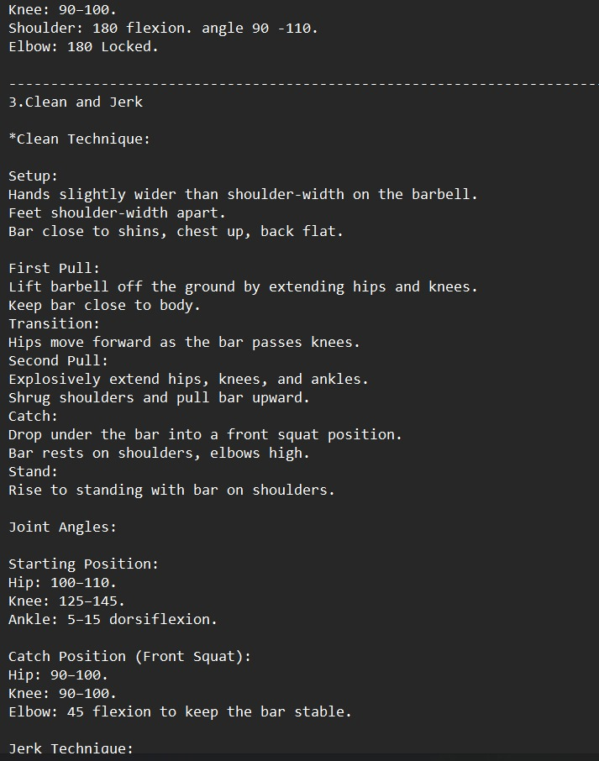
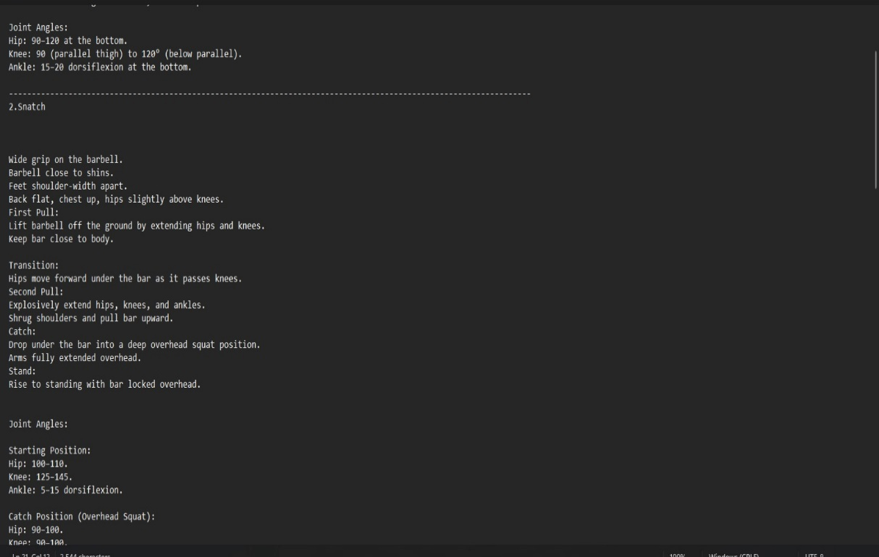
Field Visit for Data Gathering
Visit Ministry of youth and sports to gather data.
Meet personal trainer to get advices.
Data collection: A total of 976 Masters weightlifters from Australia, Canada, Europe, and the USA, ages 35 to 88 (51.1% female), completed an online survey in June 2021 that included questions on weightlifting injuries, chronic diseases, sport history, and training practices.

Slide 6
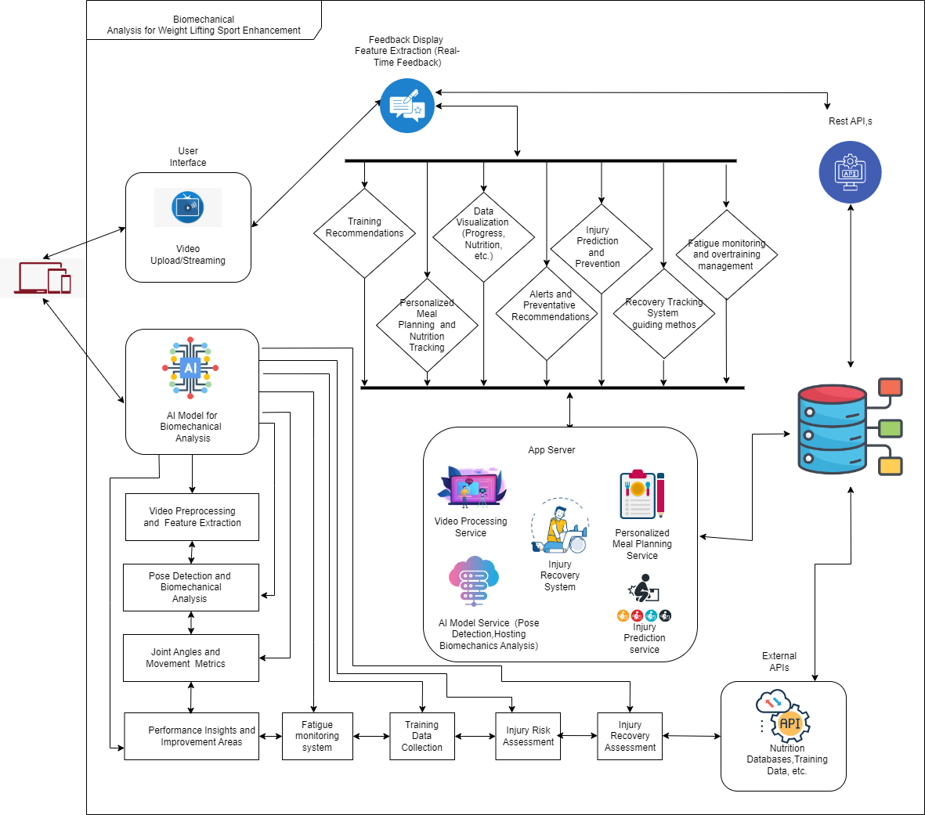
SYSTEM DIAGRAM

Slide 7
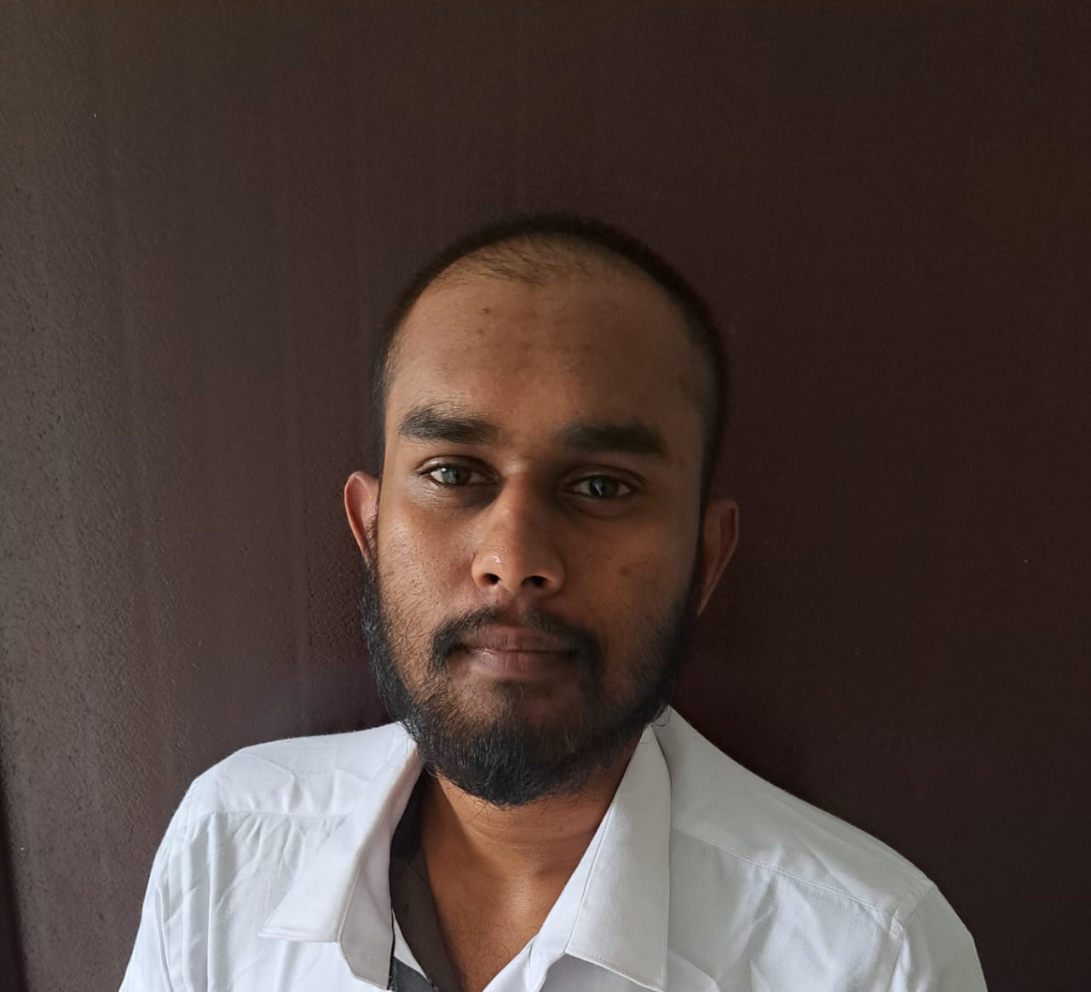
Wimalarathna S.D.A.N | IT213112
BSc (Hons) in Information Technology (Specialization in Information Technology)
IT21312212 | Wimalarathna S.D.A.N| 24-25J-275

Slide 8
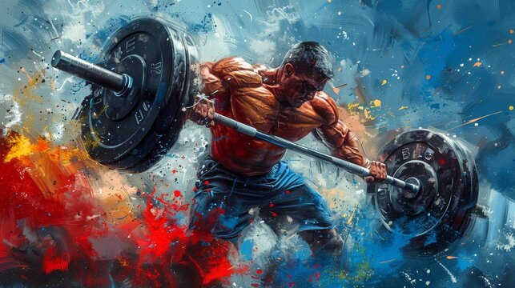
AI-Powered Video Analysis for Performance Assessment, Injury Prediction, and Fatigue Monitoring in Weightlifting
IT21312212 | Wimalarathna S.D.A.N| 24-25J-275

Slide 9
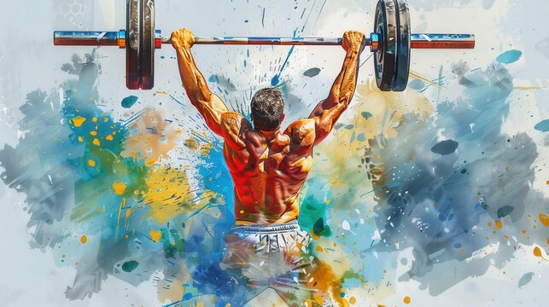
Development of an AI model that accurately analyzes weightlifters' movements from video footage and provides detailed biomechanical performance assessments, injury predictions, and fatigue monitoring specific to weightlifting techniques.
IT21312212 | Wimalarathna S.D.A.N| 24-25J-275

Slide 10
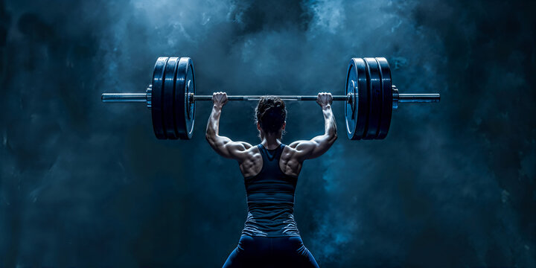
Introduction and Background of the Study
Introduction
Weightlifting is a highly technical sport that demands precise movement patterns to maximize performance and minimize the risk of injury. Traditional coaching methods rely heavily on subjective visual assessments, which can vary significantly between coaches. The advent of AI and ML technologies presents an opportunity to bring objectivity and precision to weightlifting performance analysis.
IT21312212 | Wimalarathna S.D.A.N| 24-25J-275

Slide 11
Introduction and Background of the Study
Introduction
Weightlifting is a highly technical sport that demands precise movement patterns to maximize performance and minimize the risk of injury. Traditional coaching methods rely heavily on subjective visual assessments, which can vary significantly between coaches. The advent of AI and ML technologies presents an opportunity to bring objectivity and precision to weightlifting performance analysis.
Biomechanical analysis involves studying the mechanics of human movement. In weightlifting, this analysis can provide insights into the efficiency of an athlete's technique, identify areas for improvement, and predict potential injuries. AI-powered video analysis systems can automate this process, offering real-time feedback and data-driven insights to athletes and coaches.
IT21312212 | Wimalarathna S.D.A.N| 24-25J-275

Slide 12
Introduction and Background of the Study
Introduction
Background
Biomechanical analysis involves studying the mechanics of human movement. In weightlifting, this analysis can provide insights into the efficiency of an athlete's technique, identify areas for improvement, and predict potential injuries. AI-powered video analysis systems can automate this process, offering real-time feedback and data-driven insights to athletes and coaches.
Weightlifting is a highly technical sport that demands precise movement patterns to maximize performance and minimize the risk of injury. Traditional coaching methods rely heavily on subjective visual assessments, which can vary significantly between coaches. The advent of AI and ML technologies presents an opportunity to bring objectivity and precision to weightlifting performance analysis.

Slide 13

Research Problem
Current biomechanical analysis relies on manual input.
Existing solutions lack automation.
No real-time systems for comprehensive biomechanical assessments.
Lack of injury prediction and fatigue monitoring tailored to weightlifting.
This project aims to develop an AI-powered video analysis system.
IT21312212 | Wimalarathna S.D.A.N| 24-25J-275

Slide 14
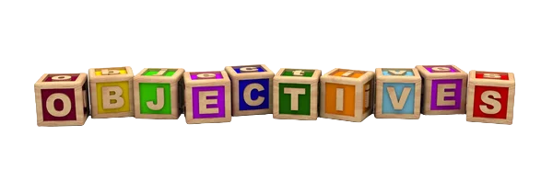
Specific Objectives
Develop an ML Model for Pose Detection and Biomechanical Analysis
Implement Real-Time Video Analysis
Provide Detailed Biomechanical Performance Assessments
Predict Potential Injuries
Monitor Fatigue Levels
IT21312212 | Wimalarathna S.D.A.N| 24-25J-275

Slide 15
Sub Objectives
Research and select appropriate algorithms for pose detection.
Annotate video footage to create a labeled dataset for training the model.
Develop a real-time video processing pipeline to handle incoming footage.
Optimize the system for low latency to provide immediate feedback during training sessions.
Develop algorithms to monitor these indicators over time.
Integrate fatigue monitoring with the real-time analysis and feedback system
IT21312212 | Wimalarathna S.D.A.N| 24-25J-275

Slide 16
Completion Of Project
Completed
Future Work
Find the Weightlifting Details Dataset
Annotate video footage to create a labeled dataset for training the weightlifting techniques model.
Develop a real-time video processing pipeline to handle incoming footage.
Develop the Performance Prediction Model.
Optimize the system for low latency to provide immediate feedback during training sessions.
Develop algorithms to monitor these indicators over time.
Create Fast Api's to connect models with Web Application and Mobile Application
Develop the real-time barbell detection
Develop Injury prediction model .
Develop fatigue monitoring model.
Frontend Development .
IT21312212 | Wimalarathna S.D.A.N| 24-25J-275

Slide 17
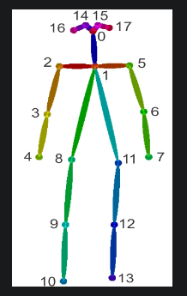
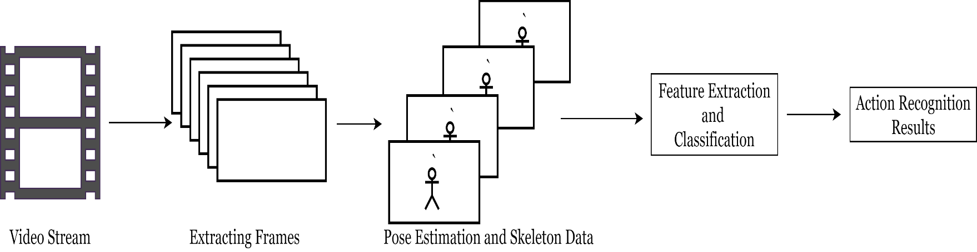
Methodology
The following figure shows the basic workflow of extracting and identifying actions done by humans in a video. For this, we have identified a suitable framework which estimates the poses of humans and represent using a skeleton showing joints of the human body
IT21312212 | Wimalarathna S.D.A.N| 24-25J-275

Slide 18
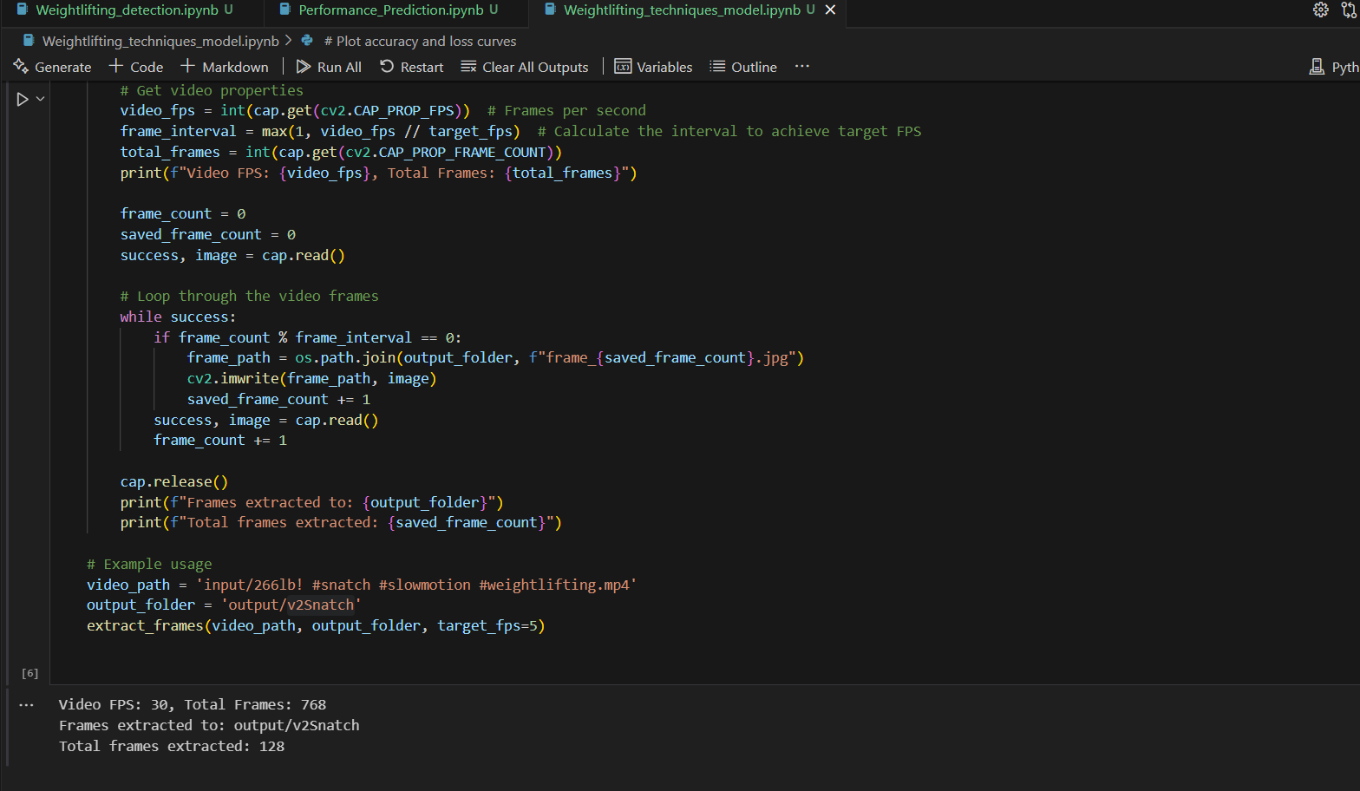
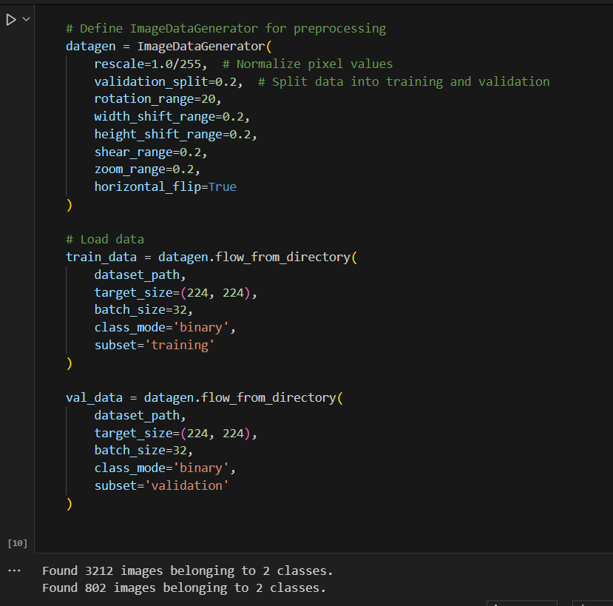
Weightlifting Technique Identification Model
Data Processing and Augmentation

Slide 19
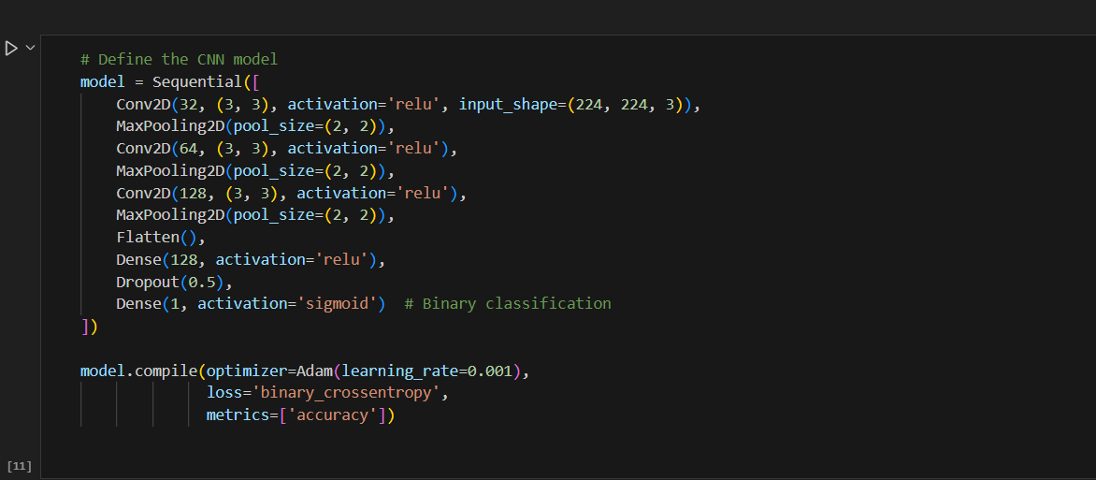
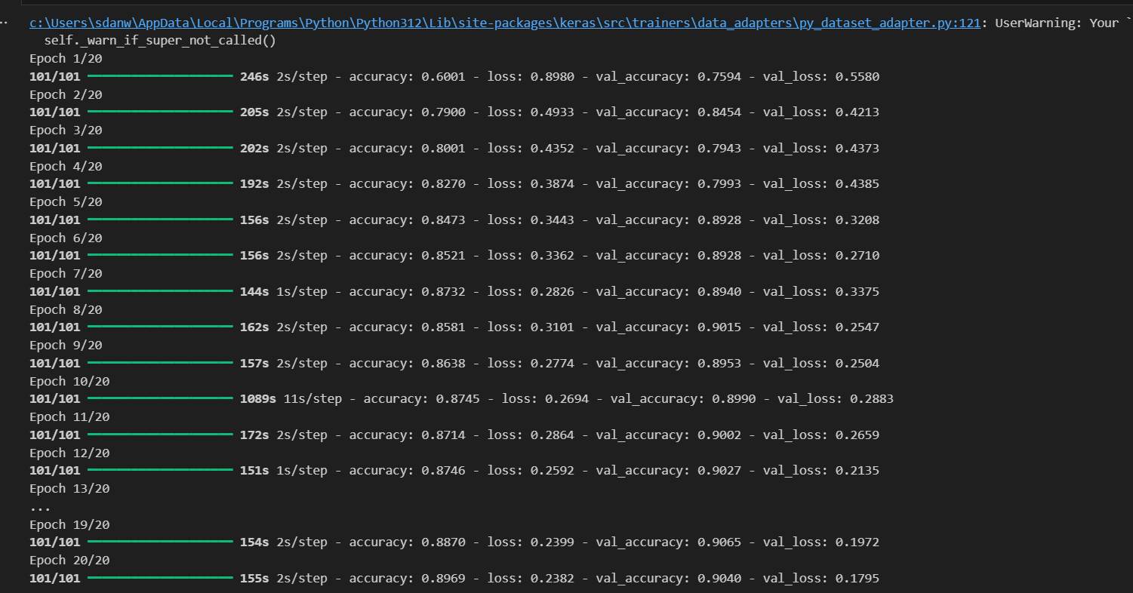
CNN Model and Model Training

Slide 20
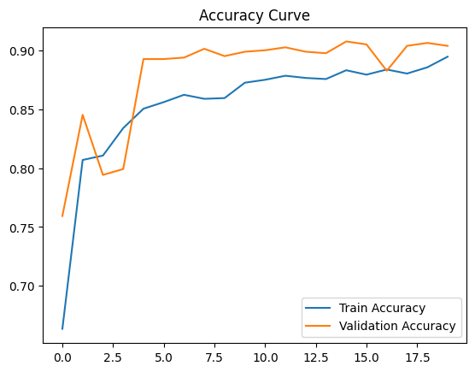
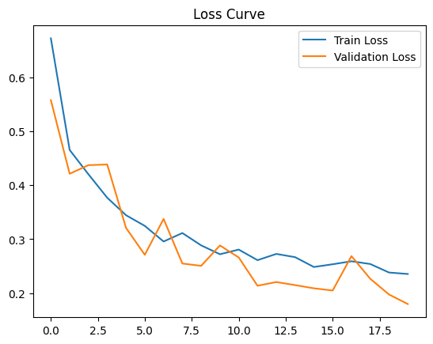
Model Accuracy

Slide 21
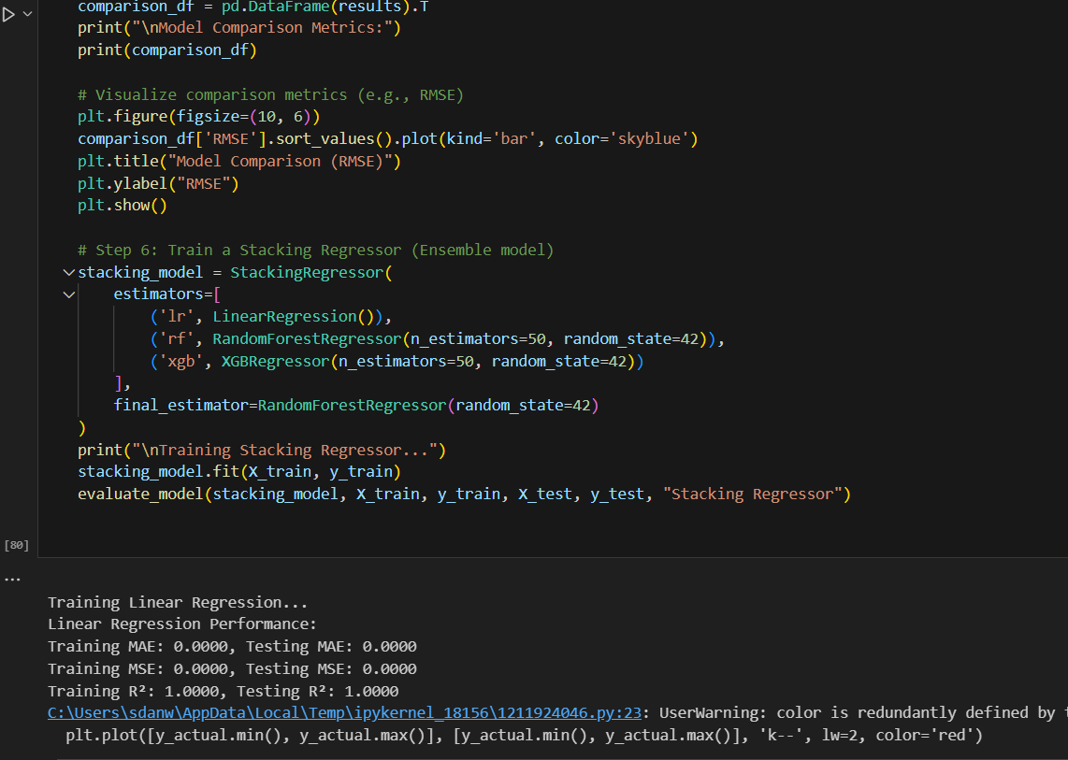
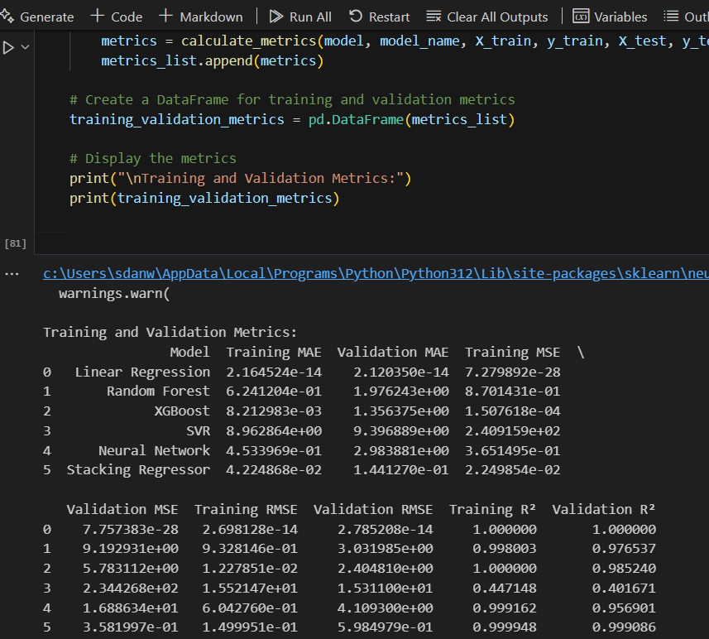
Weightlifting Performance Prediction Model
Data Processing and Augmentation

Slide 22
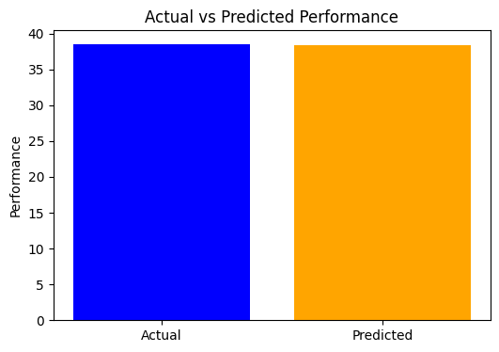
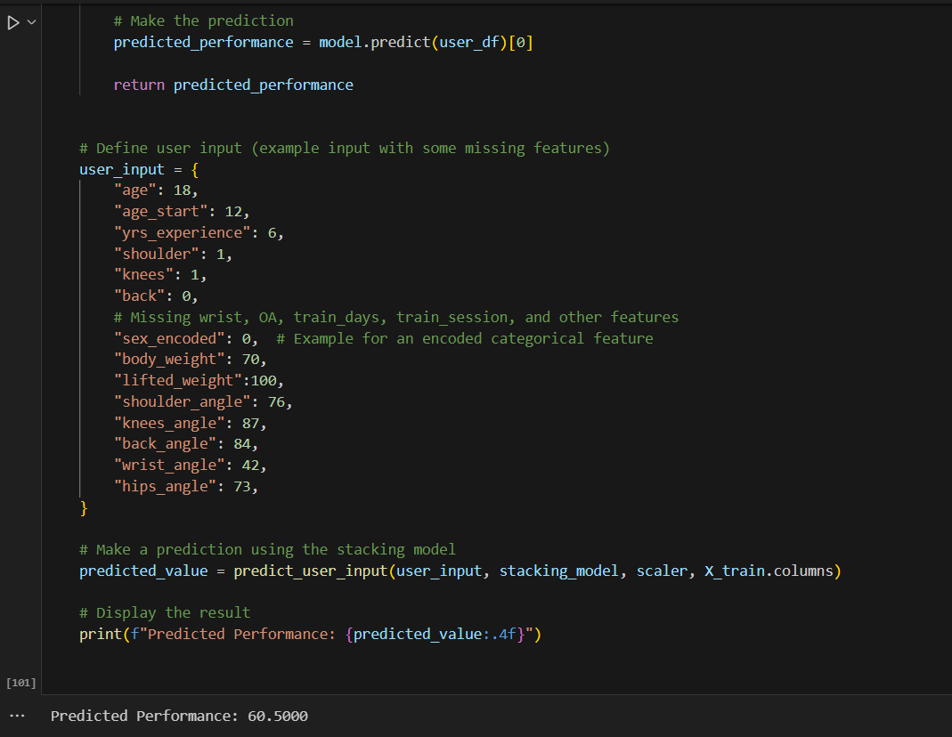
Model Training

Slide 23
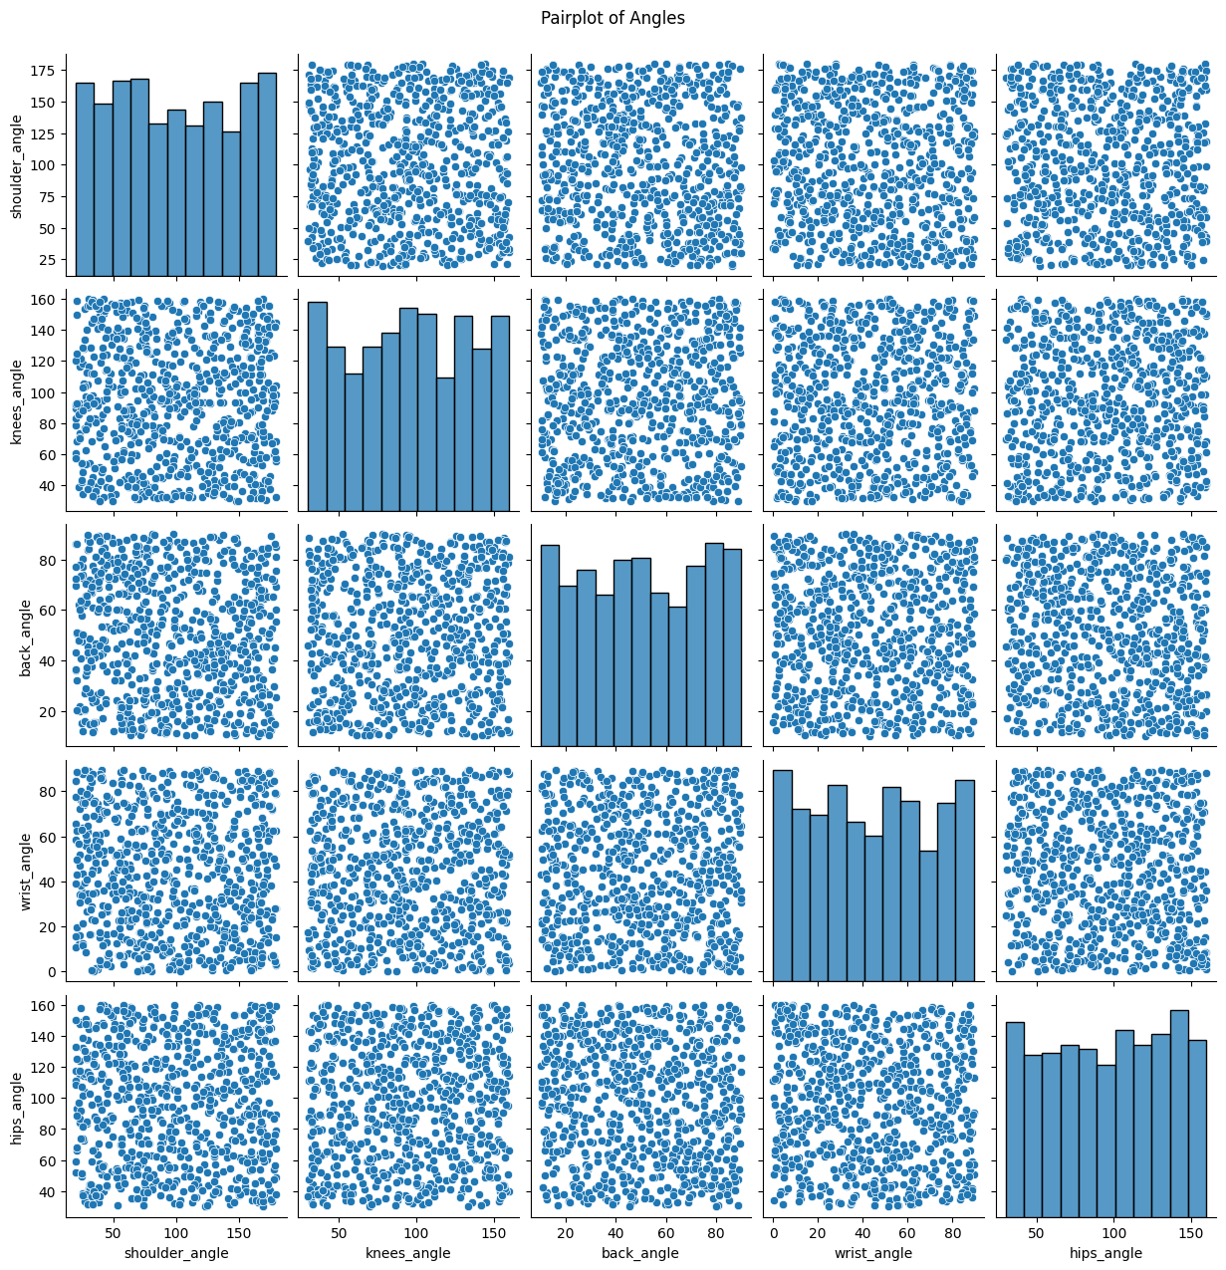
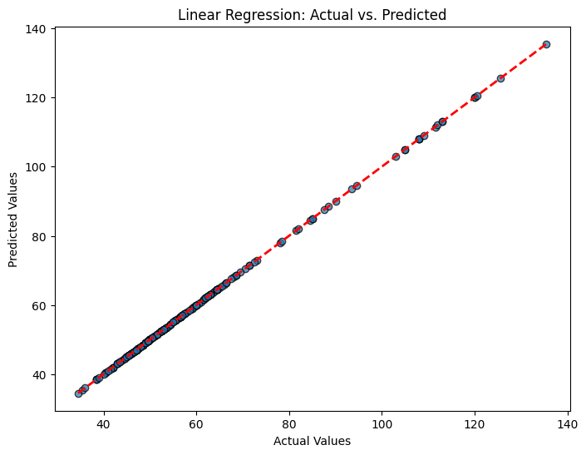
Model Accuracy

Slide 24
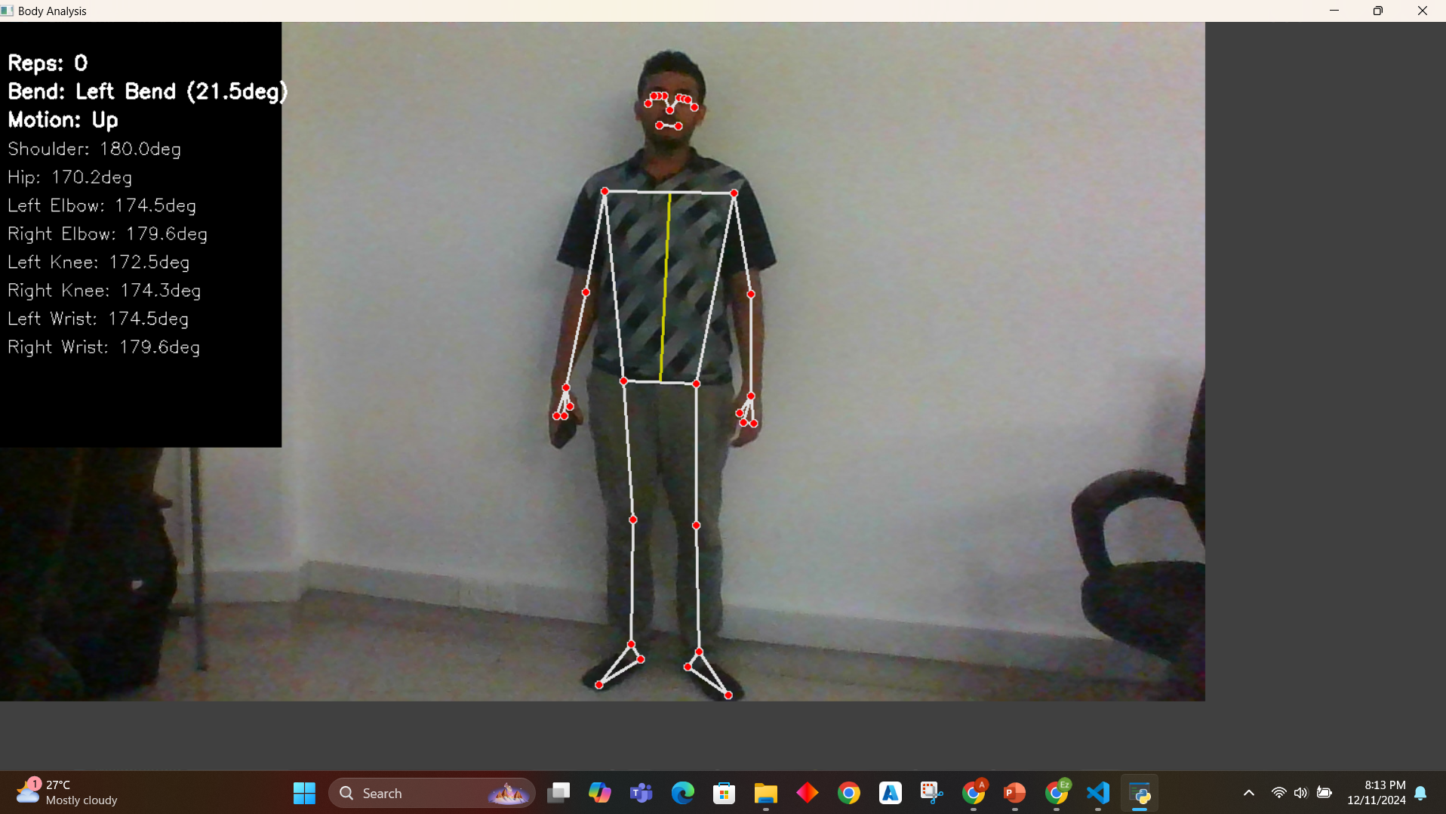
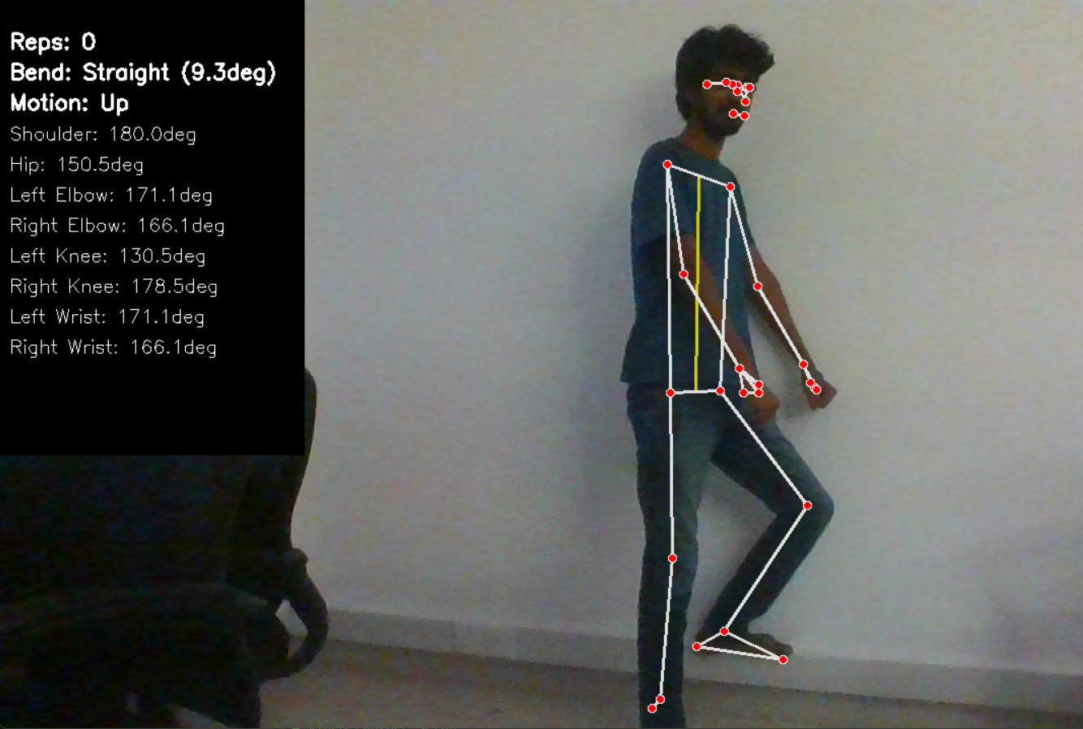
Real Time Video Processing and Prediction

Slide 25
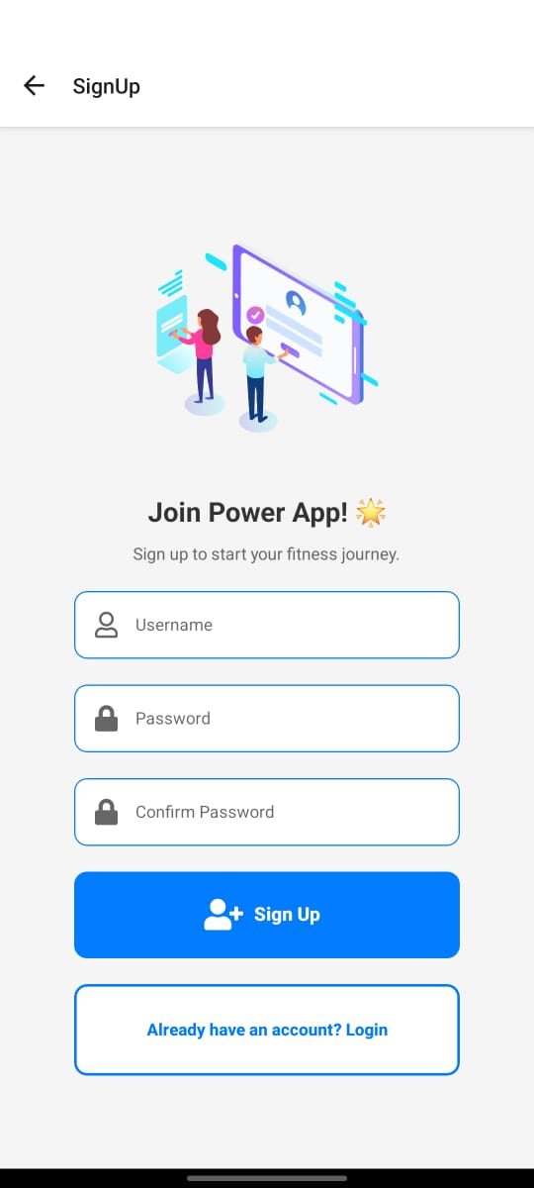
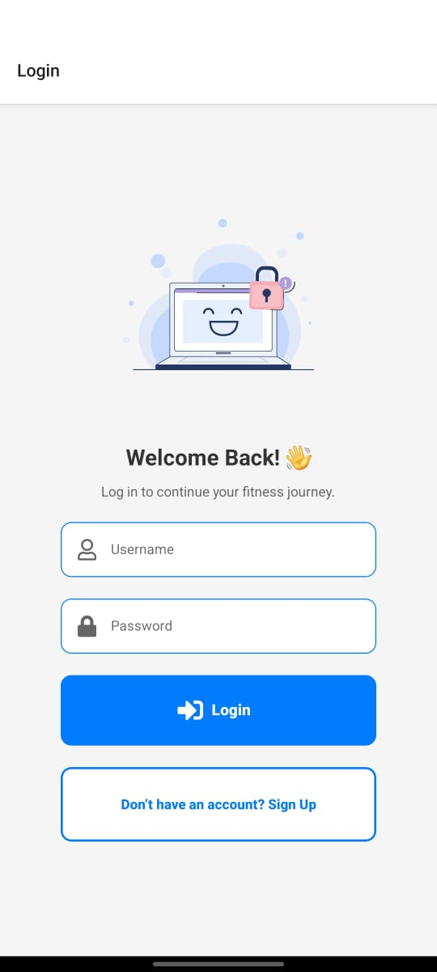
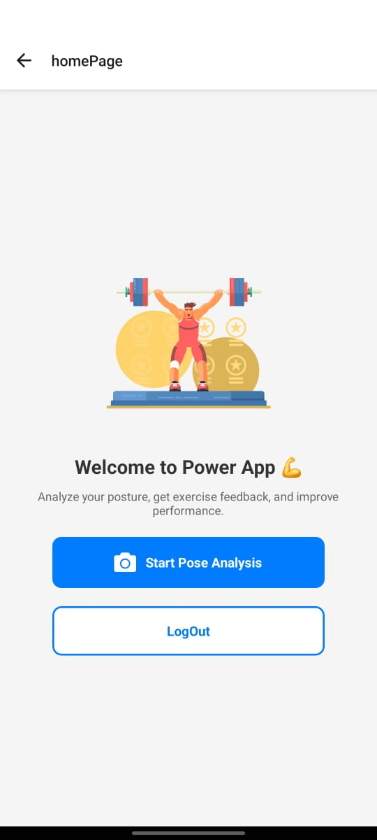
Results And Interfaces

Slide 26
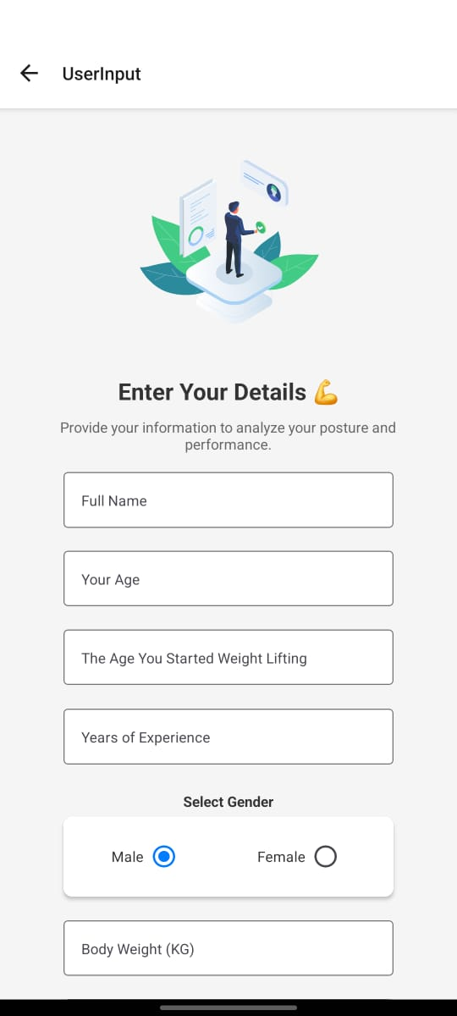
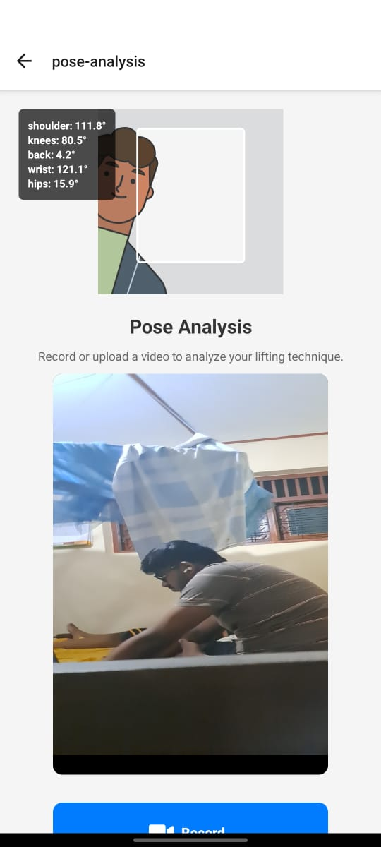
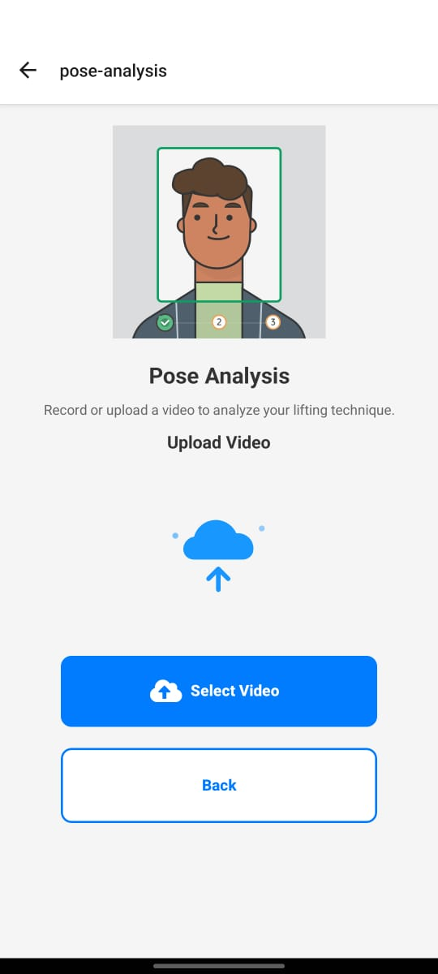
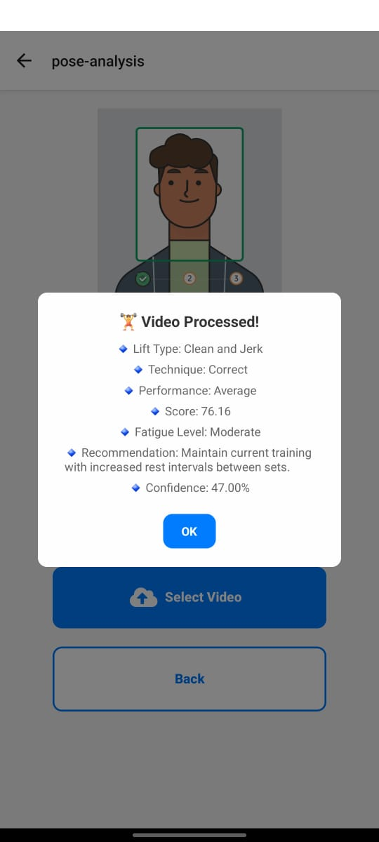
Interfaces

Slide 27
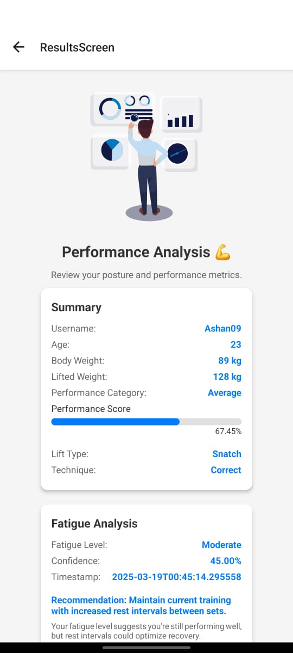
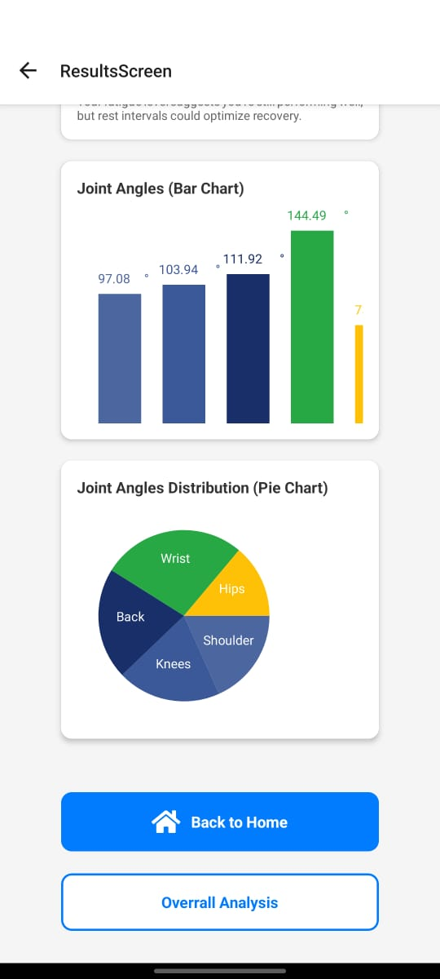
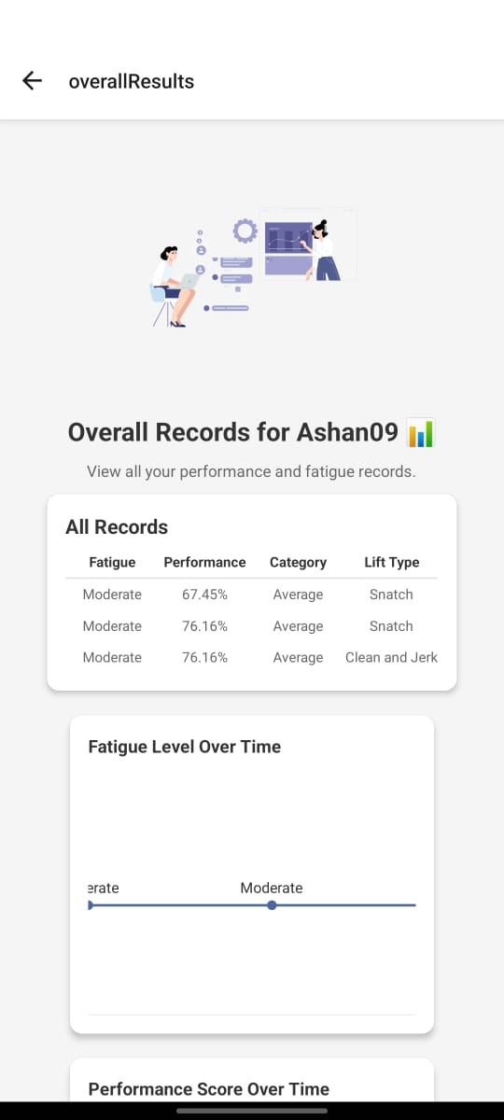
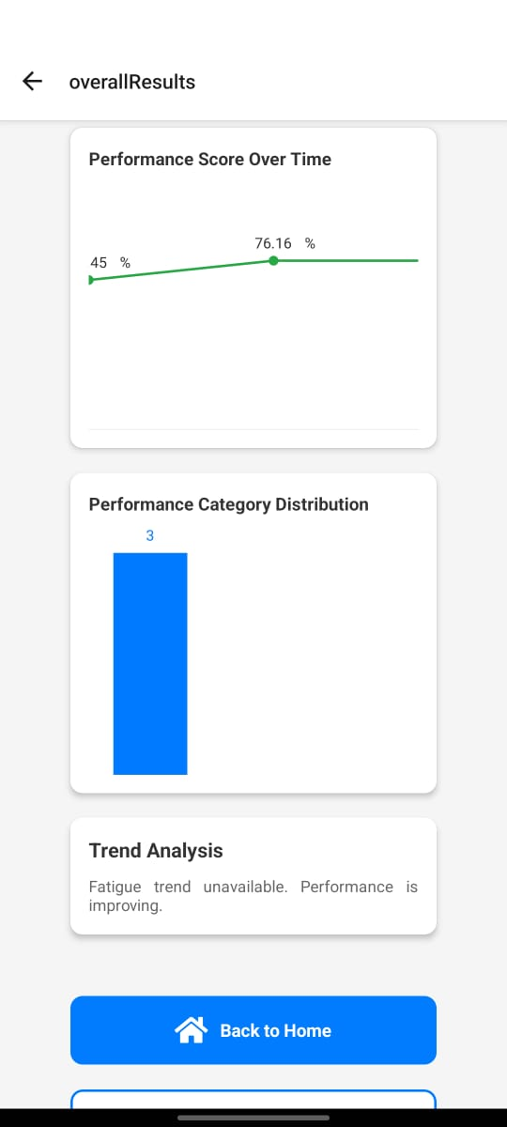
Interfaces

Slide 28
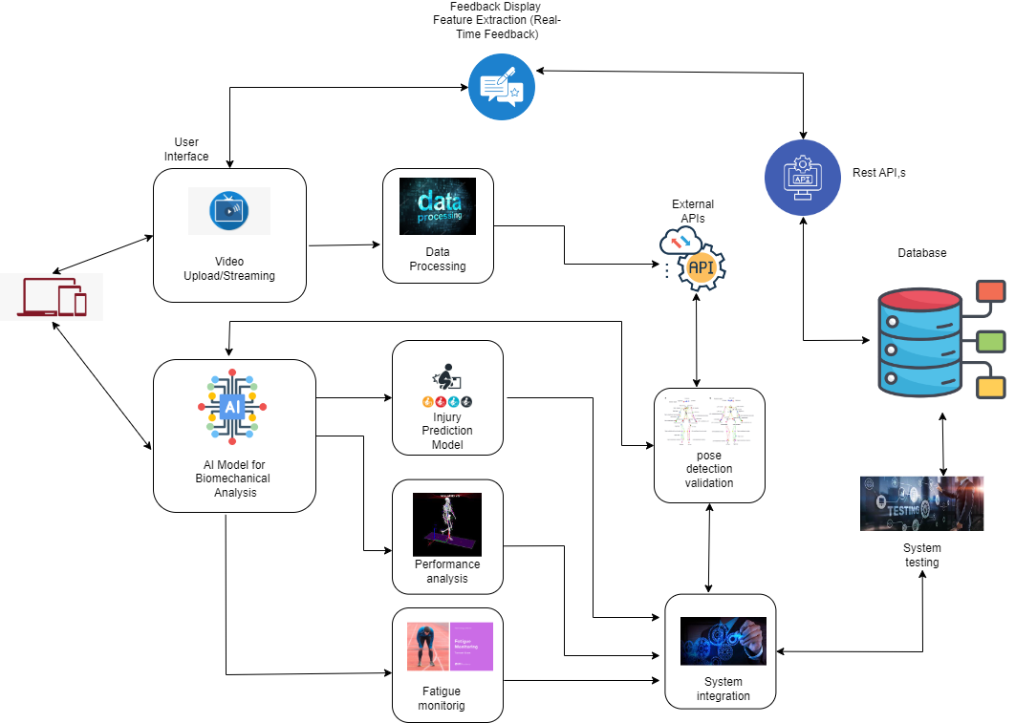
Component Overview Diagram
IT21312212 | Wimalarathna S.D.A.N| 24-25J-275

Slide 29
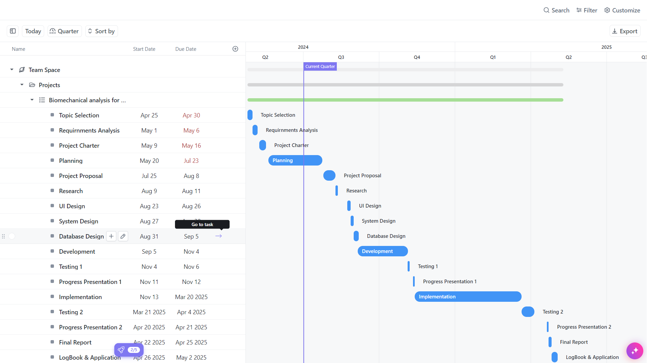
Gantt Chart
IT21312212 | Wimalarathna S.D.A.N| 24-25J-275

Slide 30
References
Applied Video Analysis for Coaches: Weightlifting Examples
https://journals.sagepub.com/doi/abs/10.1260/1747-9541.8.3.581
Objectively Measure Player Performance on Olympic Weightlifting
https://ieeexplore.ieee.org/abstract/document/9605963
Field-Based Biomechanical Assessment of the Snatch in Olympic Weightlifting Using Wearable In-Shoe Sensors and Videos
https://www.mdpi.com/1424-8220/23/3/1171
IT21312212 | Wimalarathna S.D.A.N| 24-25J-275

Slide 31
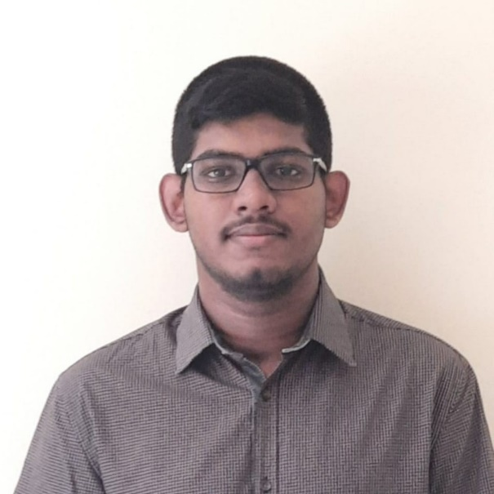
Gunawardena K.S.S | IT21250088
BSc (Hons) in Information Technology (Specialization in Information Technology)
IT21250088 | Gunawardena K.S.S | 24-25J-275

Slide 32
Real-Time Feedback, training recommendations and performance improvement using 3D models
IT21250088 | Gunawardena K.S.S | 24-25J-275

Slide 33
BACKGROUND
Lack of Accessible Tools for Real-Time Feedback in Sports Training:
Traditional coaching methods often rely on post-training reviews, which can delay corrective actions.
Many athletes and trainers lack access to advanced tools that offer immediate feedback during training sessions.
Current solutions are either too expensive or not user-friendly, making them inaccessible to amateur
athletes and small training facilities.
Need for Immediate Corrective Suggestions and Tailored Training Recommendations:
Immediate feedback can help athletes correct their form and technique in real-time, enhancing the effectiveness
of training sessions.
Tailored training recommendations can address individual athlete's strengths and weaknesses,
providing a personalized training experience.
There is a growing demand for technology that bridges the gap between professional coaching and
everyday training.
IT21250088 | Gunawardena K.S.S | 24-25J-275

Slide 34
Research Problem
How can a mobile application provide instant, personalized feedback and training advice based on real-time video analysis?
IT21250088 | Gunawardena K.S.S | 24-25J-275

Slide 35
Specific and Sub Objectives
Main Objective: Develop a mobile application for analyzing training videos and
providing real-time feedback and recommendations, demonstrate
proper techniques using 3Dmodels.
Sub Objectives:
Integrate real-time video analysis with instant corrective suggestions.
Implement interactive 3D models for demonstrating proper techniques.
Provide tailored training recommendations based on user performance.
IT21250088 | Gunawardena K.S.S | 24-25J-275

Slide 36
Completion and Future works
Completion of the components
Future Implementations
Create Human 3D models.
Add barbell to the 3d models and completion.
Add animations to the created models.
Complete the mobile app and integration.
Start to create mobile application.
Provide training recommendations and
feedbacks.
IT21250088 | Gunawardena K.S.S | 24-25J-275

Slide 37
METHODOLOGY
IT21250088 | Gunawardena K.S.S | 24-25J-275

Slide 38
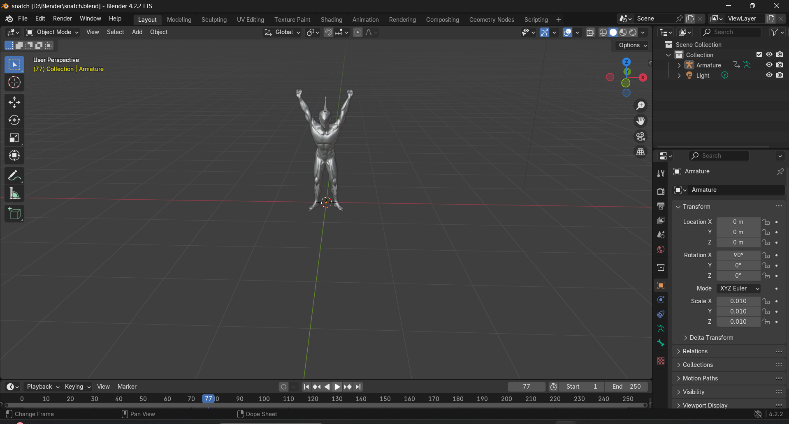
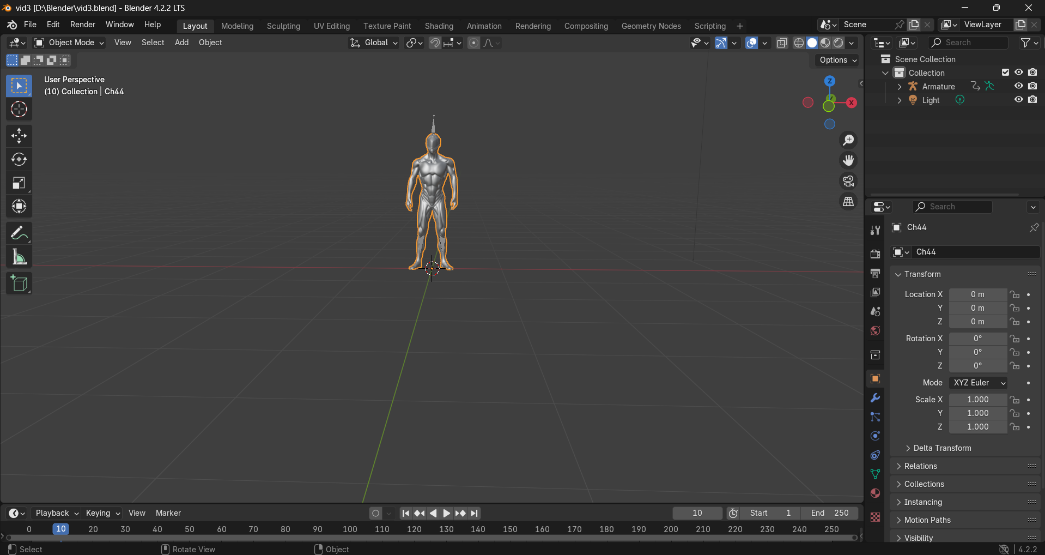
Create 3D models
IT21250088 | Gunawardena K.S.S | 24-25J-275

Slide 39
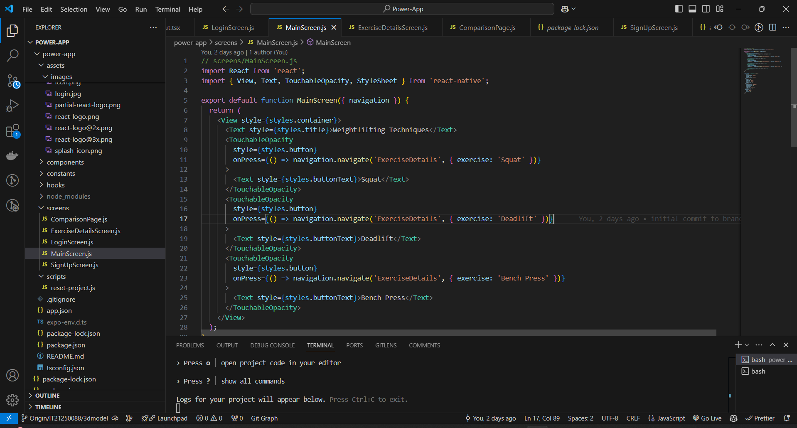
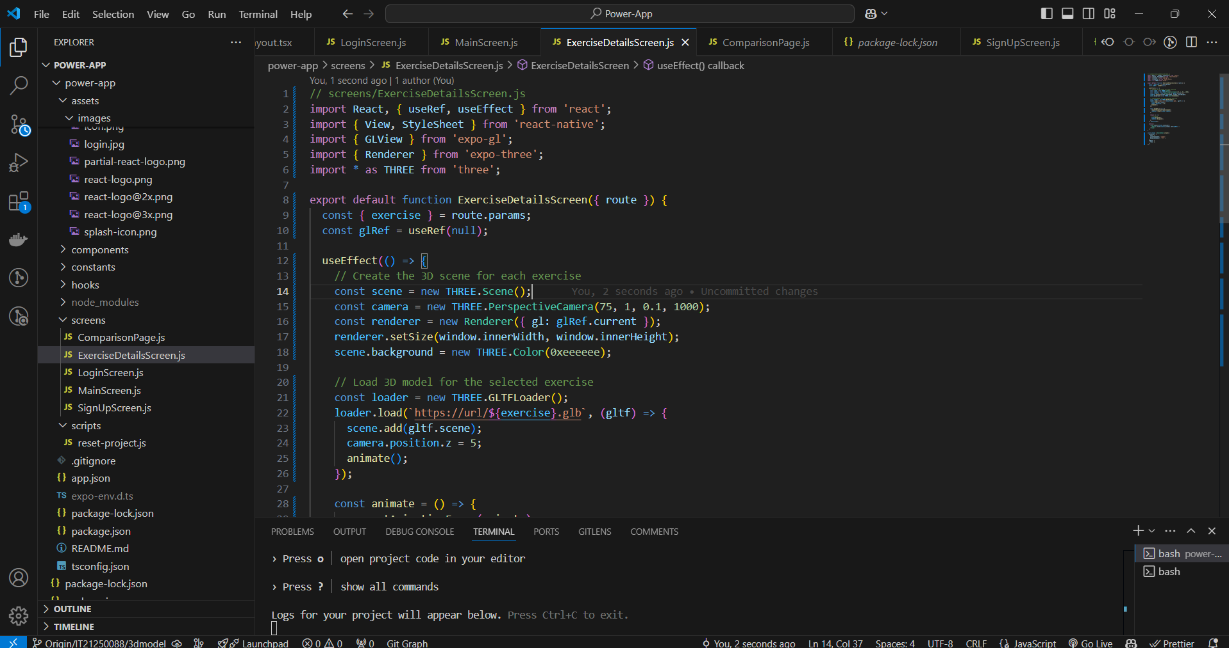
Create Mobile application
IT21250088 | Gunawardena K.S.S | 24-25J-275

Slide 40
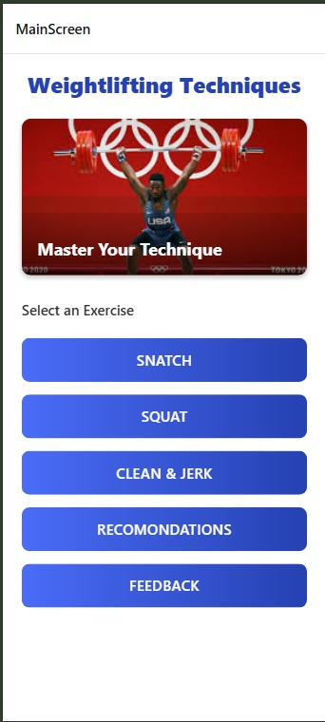
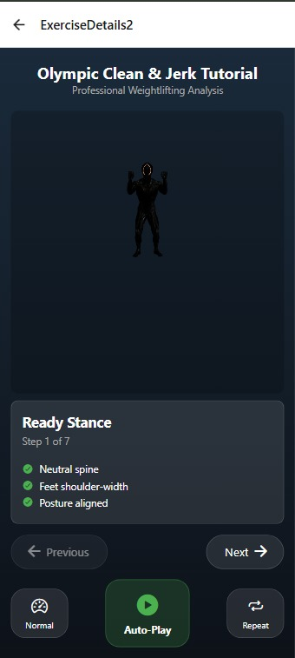
Create Mobile application
IT21250088 | Gunawardena K.S.S | 24-25J-275

Slide 41
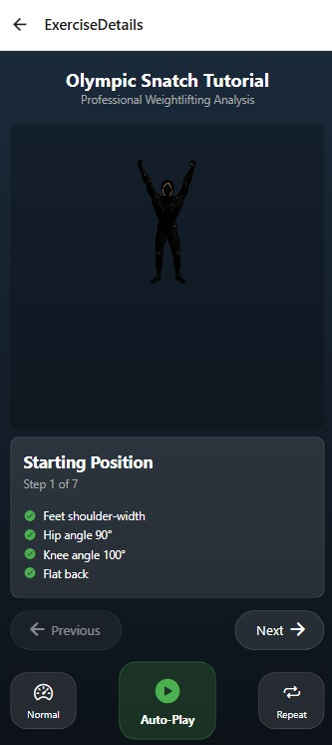
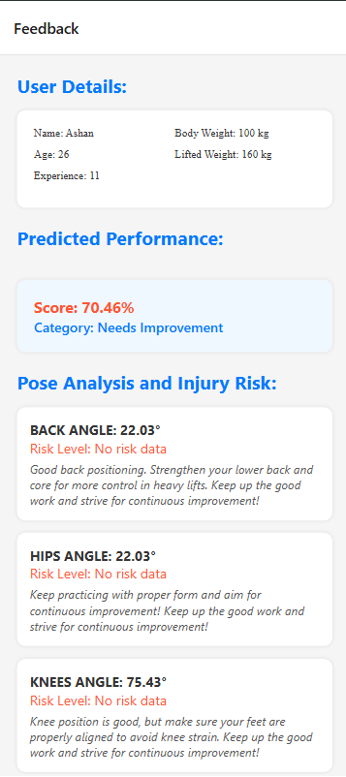
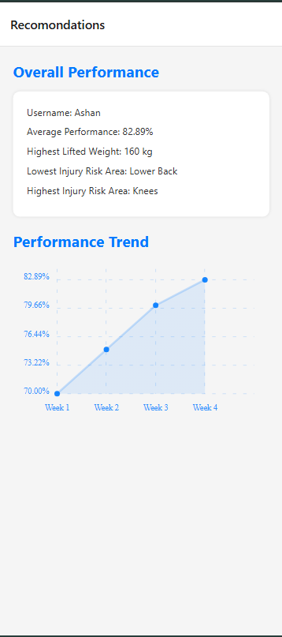
Create Mobile application
IT21250088 | Gunawardena K.S.S | 24-25J-275

Slide 42
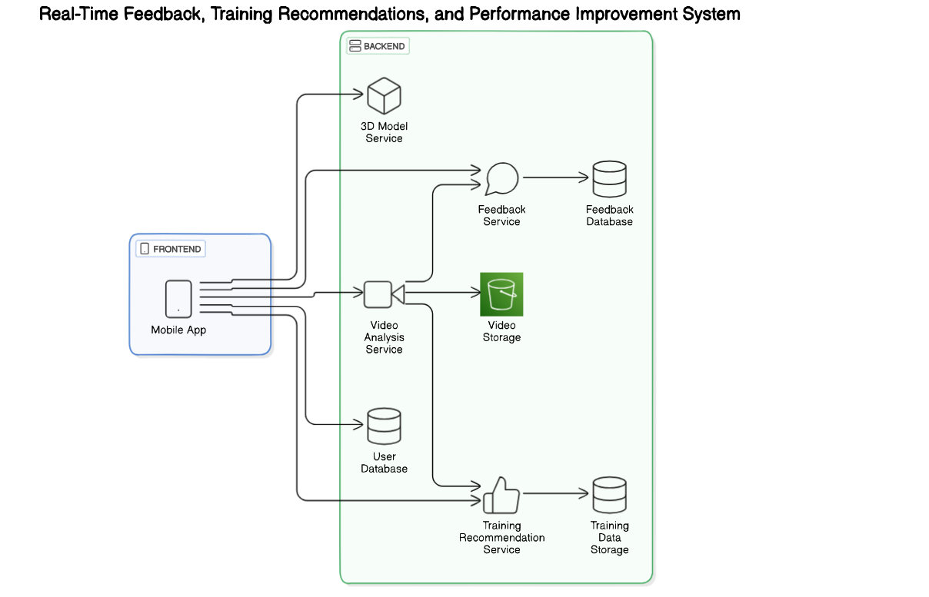
System Diagram
IT21250088 | Gunawardena K.S.S | 24-25J-275

Slide 43
Technologies to be Used
Computer vision
AI/ML algorithms
Mobile app development frameworks :React Native
3D modeling tools :Unity, Blender
IT21250088 | Gunawardena K.S.S | 24-25J-275

Slide 44
System, Personal, and Software Requirements Specification
System Requirements: Smartphones with camera capability, internet access.
Personal Requirements: Users with basic smartphone handling skills.
Software Requirements: Operating systems (iOS/Android), necessary libraries for AI and 3D modeling.
IT21250088 | Gunawardena K.S.S | 24-25J-275

Slide 45
Gantt Chart

Slide 46
References
Development of a real‐time performance measurement and feedback system for alpine skiers
https://www.tandfonline.com/doi/abs/10.1080/19346182.2009.9648498
Development of a Real-time Weightlifting Performance Feedback System.
https://openurl.ebsco.com/EPDB%3Agcd%3A11%3A19632427/detailv2?sid=ebsco%3Aplink%3Ascholar&id=ebsco%3Agcd%3A19947231&crl=c
WEIGHT LIFTING TECHNOLOGY BIOMECHANICS RAPID FEED BACK SYSTEM STUDY
https://ojs.ub.uni-konstanz.de/cpa/article/view/5674
Realtime weightlifting barbell trajectory extraction and performance analysis.
https://openurl.ebsco.com/EPDB%3Agcd%3A10%3A2281914/detailv2?sid=ebsco%3Aplink%3Ascholar&id=ebsco%3Agcd%3A128965737&crl=c
THE DEVELOPMENT OF A REAL-TIME FEEDBACK SYSTEM IN WEIGHTLIFTING
https://ojs.ub.uni-konstanz.de/cpa/article/view/5969

Slide 47

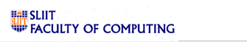
IT21315732 | RanaWEERA I.U.
BSc (Hons) in Information Technology (Specialization in Information Technology)
IT21315732 | Ranaweera I.U | 24-25J-275

Slide 48

Advanced Personalized Meal Planning System Tailored for Weightlifting Athletes Includes Food Recommendations to Facilitate Faster Injury Recovery.
IT21315732 | Ranaweera I.U | 24-25J-275

Slide 49
Background
Professional weightlifting athletes require highly personalized nutrition plans to optimize their injury recovery, meet specific weight goals and performance.
Current meal planning systems often lack the ability to dynamically adjust based on an athlete's changing needs and conditions, such as injuries or budget constraints.
The introduction of a new mobile app platform can significantly enhance the meal planning process for athletes by leveraging advanced technologies.
Athletes will receive meal plans that are specifically designed to meet their unique needs and goals, leading to faster recovery and better performance.
Voice-assisted inputs and NLP ensure that athletes can easily communicate their needs and preferences, making the app more interactive and efficient.
IT21315732 | Ranaweera I.U | 24-25J-275

Slide 50
RESEARCH PROBLEM
Currently, there is no easy-to-use meal planning system tailored for weightlifting athletes that also includes food recommendations to facilitate faster injury recovery. Existing solutions often lack personalization and fail to consider the unique dietary needs of athletes
How to Identify and Recommend Specific Foods for Faster Injury Recovery ?
How to Develop a Machine Learning Model for Personalized Meal Planning Focused on Injury Recovery ?
How to Integrate Voice Assistant and Natural Language Processing (NLP) for Dynamic Meal Plan Adjustments ?
IT21315732 | Ranaweera I.U | 24-25J-275

Slide 51
Specific Objective
Develop a mobile application that provides personalized meal plans for professional weightlifting athletes with continuous adjustment and optimization, considering factors such as injury recovery, preferences, performance, budget and weight goals.
Sub Objectives
Gather information on the nutritional requirements and recovery needs specific to weightlifting athletes.
Collect and preprocess data on athletes' dietary habits, injury history, food preferences, weight goals, allergies and budget preferences.
Incorporate algorithms to prioritize nutrients and dietary components that support injury recovery.
Select and train a machine learning model that can integrate and process these diverse factors to recommend optimal meal plans.
Integrate voice assistant capabilities into the mobile app to facilitate user-friendly and interactive meal plan adjustments.
IT21315732 | Ranaweera I.U | 24-25J-275

Slide 52
METHODOLOGY
IT21250088 | Gunawardena K.S.S | 24-25J-275

Slide 53
Technologies and Techniques
React Native
Python
RandomForestRegressor
Natural Language Processing Techniques
IT21315732 | Ranaweera I.U | 24-25J-275

Slide 54

System Diagram
IT21315732 | Ranaweera I.U | 24-25J-275

Slide 55



Interfaces
IT21315732 | Ranaweera I.U | 24-25J-275

Slide 56



Interfaces
IT21315732 | Ranaweera I.U | 24-25J-275

Slide 57


Model Training
IT21315732 | Ranaweera I.U | 24-25J-275

Slide 58
Gantt Chart

Slide 59
References
[1] Changhun Lee, Jayun Kim, “Diet Planning with Machine Learning: Teacher-forced REINFORCE for Composition Compliance with Nutrition Enhancement “, 2021.
[2] M.Geetha, C.Saravanakumar, K.Ravikumar, V.Muthulakshmi, “Human Body Analysis and Diet Recommendation System using Machine Learning System”, 2021.
[3] Reema Golagana, V. Sravani, T. Mohan Reddy, CH Kavitha, “DIET RECOMMENDATION SYSTEM USING MACHINE LEARNING”, 2023.
[4] N.Mustafa, A.H.A.Rahman, N.S.Sani, M.I.Mohamad, “iDietScoreTM: Meal Recommender System for Athlete and Active Individuals
https://dl.acm.org/doi/pdf/10.1145/3447548.3467201
https://books.google.lk/books?hl=en&lr=&id=wmleEAAAQBAJ&oi=fnd&pg=PA247&dq=meal+plan+system+with+machine+learning&ots=gk86HF4Y0c&sig=wczrSS29LXQh9vZo6spVHQQI_yY&redir_esc=y#v=onepage&q=meal%20plan%20system%20with%20machine%20learning&f=false
https://journal-dogorangsang.in/no_1_Online_23/20_apr.pdf
https://www.researchgate.net/profile/Nor-S-Sani/publication/348271827_iDietScore_Meal_Recommender_System_for_Athletes_and_Active_Individuals/links/5ffe7c0d299bf140888f9b6d/iDietScore-Meal-Recommender-System-for-Athletes-and-Active-Individuals.pdf
IT21315732 | Ranaweera I.U | 24-25J-275

Slide 60

IT21313134 | Ranatunga B.M.
BSc (Hons) in Information Technology (Specialization in Information Technology)
IT21313134 | Ranatunga B.M. | 24-25J-275

Slide 61
Background
In the world of weightlifting, injuries are a common obstacle that athletes face.
Efficient rehabilitation and accurate tracking of recovery progress are crucial for athletes to return to their peak performance levels.
Traditional rehabilitation methods often lack real-time feedback and precise tracking, leading to prolonged recovery times and suboptimal outcomes.
IT21313134 | Ranatunga B.M. | 24-25J-275

Slide 62
Introduction
Our project, Recovery Tracking System with Mobile Camera Integration, aims to revolutionize the rehabilitation process for weightlifting athletes.
Developed Targeted Movement Analysis.
Provide Real-Time Feedback on Exercise Form.
Reps Counting in Rehabilitation Exercise Tracking
IT21313134 | Ranatunga B.M. | 24-25J-275

Slide 63
Research Gap
Manual Tracking Systems:
Limitations: Manual systems rely heavily on user input and subjective reporting. They lack real-time feedback and objective measurements, leading to inconsistencies and potential inaccuracies in tracking recovery progress.
Standard Exercise Apps:
Limitations: Most exercise apps provide generic workout plans and lack the capability to personalize exercises based on individual injury types and recovery needs. They do not offer real-time form correction or comprehensive progress tracking.
Wearable Technology:
Limitations: While wearables can track certain metrics like heart rate and movement, they often require additional devices and are limited in their ability to provide detailed movement analysis and real-time feedback on form correction.
IT21313134 | Ranatunga B.M. | 24-25J-275

Slide 64
Research Problem
How can we improve the rehabilitation process using mobile camera integration ?
IT21250088 | Gunawardena K.S.S | 24-25J-275

Slide 65

Specific and Sub Objectives
MAIN OBJECTIVES
To develop Recovery Tracking System using mobile camera integration that enhances the rehabilitation process
IT21313134 | Ranatunga B.M. | 24-25J-275

Slide 66
Sub Objectives
Detect and analyze movements during exercises.
Count the reps of exercises
Give messages the when the movement is incorrect
IT21313134 | Ranatunga B.M. | 24-25J-275

Slide 67
METHODOLOGY
IT21250088 | Gunawardena K.S.S | 24-25J-275

Slide 68


TECHNOLOGIES TO BE USED
Mobile application frameworks – React Native
Mobile Camera Technology
Pose Estimation Algorithms – Opencv / mediapipe
Machine Learning – VScode, PyTorch
IT21313134 | Ranatunga B.M. | 24-25J-275

Slide 69

SYSTEM DIAGRAM
IT21313134 | Ranatunga B.M. | 24-25J-275

Slide 70


Rehabilitation protocols
https://orthoinfo.aaos.org/globalassets/pdfs/2024-rotator-cuff-and-shoulder-conditioning-program.pdf
https://orthoinfo.aaos.org/globalassets/pdfs/2023-rehab_knee.pdf
IT21313134 | Ranatunga B.M. | 24-25J-275

Slide 71


exercises detection models
IT21313134 | Ranatunga B.M. | 24-25J-275

Slide 72


Model Accuracy
IT21313134 | Ranatunga B.M. | 24-25J-275

Slide 73




User Interfaces
IT21313134 | Ranatunga B.M. | 24-25J-275

Slide 74


Real time detection
IT21313134 | Ranatunga B.M. | 24-25J-275

Slide 75
System, Personal, and Software Requirements Specification
System Requirements:
High-resolution camera (at least 1080p).
Sufficient processing power (quad-core processor or higher).
Minimum of 4GB RAM.
Internet connection
Software Requirements:
Mobile Operating System(Android/iOS)
IT21313134 | Ranatunga B.M. | 24-25J-275

Slide 76
System, Personal, and Software Requirements Specification
Personal Requirements
Basic understanding of using mobile applications.
Little knowledge of rehabilitation exercises.
IT21313134 | Ranatunga B.M. | 24-25J-275

Slide 77

Gantt Chart

Slide 78
References
A Computer Vision-Based System for Real-Time Feedback in Physical Therapy
https://link.springer.com/article/10.1007/s00530-021-00815-4
Personalized Exercise Plans Using Machine Learning
https://journals.sagepub.com/doi/full/10.1177/20552076241233247
Wearable Sensors for Objective Measurement in Rehabilitation
https://www.ncbi.nlm.nih.gov/pmc/articles/PMC6700726/#:~:text=Wearable%20motion%20sensors%20enable%20the,guide%20and%20enhance%20rehabilitation%20activities.
Gait Analysis and Tracking System with Real-Time Feedback
https://reev.care/blog/reev-sense/how-can-real-time-gait-analysis-enhance-patient-care-and-outcomes/

Slide 79
Budget
Component | Cost(USD) | Cost(LKR)
Model Development | 20$ | Rs 6000
Hosting Mobile App | 25$ | Rs 7500
Internet Usage | 10$ | Rs 3000
Cloud Server | 10$ | Rs 3000
Other Cost | 20$ | Rs 6000
Total | 85$ | Rs 25 500

Slide 80
Commercialization Strategy
Target Market:
Weightlifting organizations (e.g., gyms, sports clubs)
Professional weightlifting teams and athletes
Training and rehabilitation centers
Collaborate with weightlifting federations and professional athletes to endorse the product
Publish articles, case studies, and success stories showcasing the benefits of the system
Create video tutorials and webinars to educate potential customers on using the software.

Slide 81


